Slide 1
Carrier counseler
Presented By:
Khushi pandey
COLLEGE: vision institute of technology
DEPARTMENT: Computer science

Slide 2
OUTLINE
Problem Statement
Technology used
Wow factor
End users
Result
Conclusion
Future Scope
IBM certification

Slide 3
Problem Statement
Students often struggle to make informed career decisions due to fragmented access to guidance, limited self-awareness of academic strengths, and rapidly evolving industry landscapes. Traditional counseling methods lack personalization and scalability, leading to missed opportunities and career mismatches. The challenge is to develop an intelligent, autonomous agent that continuously monitors student performance, evolving interests, and real-time labor market trends to deliver tailored career pathway suggestions. This would empower students to make confident, future-ready decisions with minimal dependency on manual intervention.

Slide 4
Technology used
IBM cloud lite services
Natural language processing
Retrieval Augumented Generation(RAG)
IBM Granite model

Slide 5
IBM CLOUD SERVICES USED
IBM Cloud account with Watsonx.ai and Watson Assistant access
IBM cloud watsonx.AI studio
IBM cloud watsonx.AI runtime
IBM cloud agent lab
IBM granite foundation model

Slide 6
Wow factors
Hyper-Personalized & Adaptive Guidance:
Dynamic career mapping based on continuous learning of skills, interests, and experiences.
Personalized learning paths and resources to fill skill gaps identified by the AI system.
Predictive analytics to forecast future job market trends and recommend proactive upskilling.
Virtual Reality Career Simulations: Allow users to "test-drive" various careers through immersive VR simulations, experiencing the daily tasks, environment, and challenges of different roles before committing.
Interactive Learning & Skill Development: Gamified learning modules, interactive exercises, and simulations within the platform can make skill development engaging and effective.
"Show, Don't Just Tell" Approach: Offer VR-based visualizations of complex concepts or career paths to enhance understanding and engagement, as opposed to solely text or generalized recommendations.

Slide 7
END USERS
Academic students
Educators
Marketers
Private Employees
etc

Slide 8
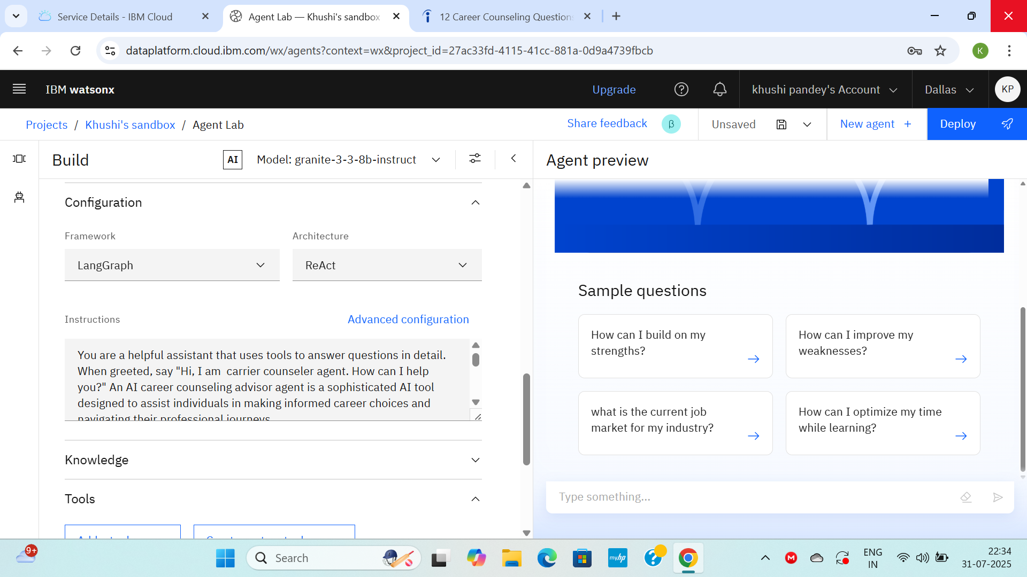
results

Slide 9
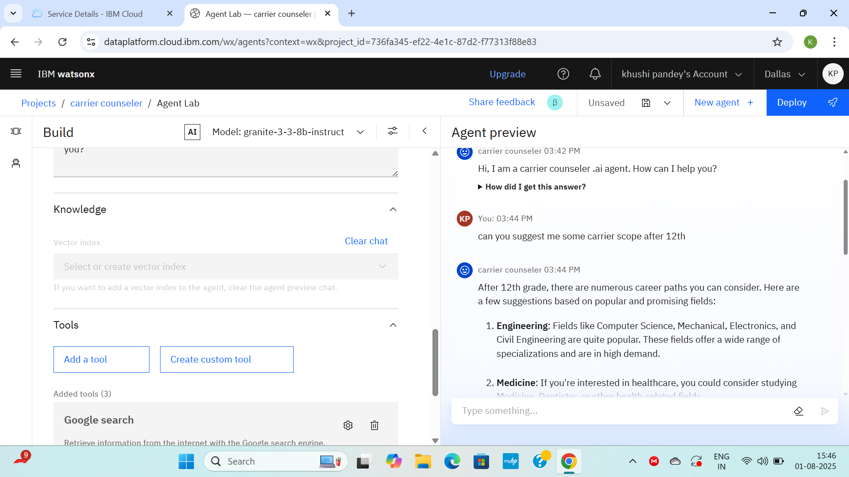
results

Slide 10
conclusion
Agentic AI holds immense potential to transform career counseling, making it more personalized, efficient, and accessible according to allegiance-educare.in. By addressing ethical concerns and emphasizing human-AI collaboration, these counselors can empower individuals and enhance career development in the dynamic world of work.

Slide 11
future scope
Agentic AI Career Counselors: The Future of Career Guidance
Personalized & Data-Driven Insights: Provide tailored career paths and skill development plans based on individual profiles and real-time market data.
Proactive Guidance: Identify skill gaps and suggest relevant learning opportunities to boost employability.
Enhanced Job Search: Optimize resumes, offer mock interviews, and streamline job search processes.
Increased Accessibility & Continuous Learning: Available 24/7 and adapt to evolving skills and market trends.

Slide 12
Github link

Slide 13
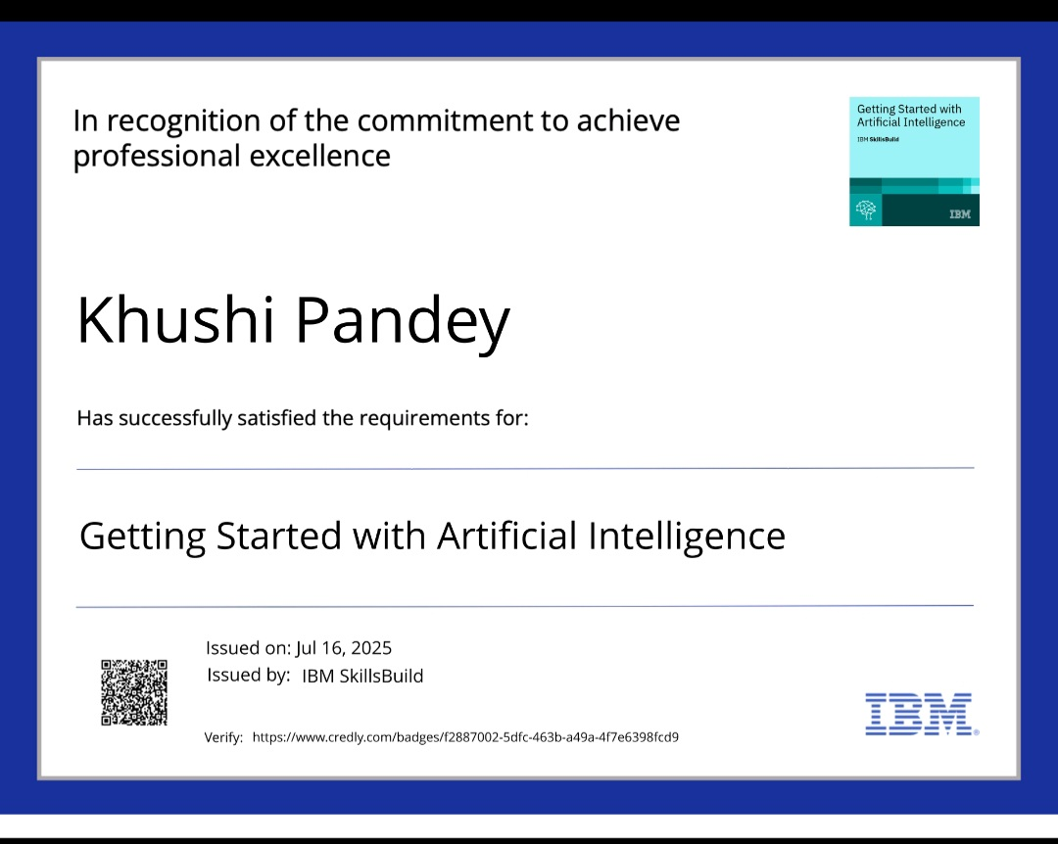
IBM Certifications

Slide 14
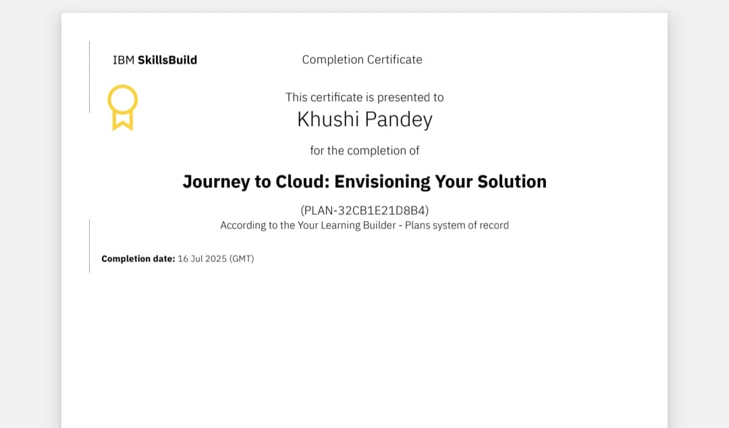
IBM Certifications

Slide 15
THANK YOU

